Slide 1

6th Grade Accelerated Math
Unit 6, Lesson 2 Prime Factorization Volume 1, pg. 238

Slide 2


Benchmark
MA.6.NSO.3.4
Express composite whole numbers as a product of prime factors with natural number exponents.
volume 1, pg. 238

Slide 3
Integrated Mathematical Thinking and Reasoning Standards
MA.K12.MTR.4.1 Engage in discussions that reflect on the mathematical thinking of self and others.
MA.K12.MTR.5.1 Use patterns and structure to help understand and connect mathematical concepts.
volume 1, pg. 238

Slide 4

Learning Target
I can express composite whole numbers as a product of prime factors.
volume 1, pg. 238

Slide 5

Warm-Up
volume 1, pg. 238

Slide 6
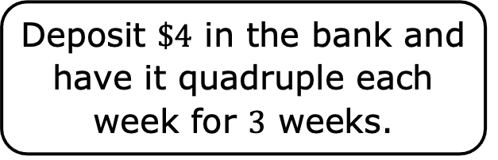
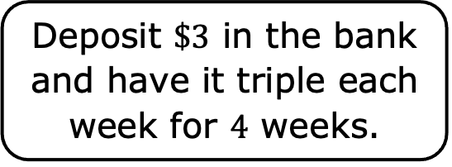
6.2.1 Warm-Up: Would You Rather?
Which of the following would you rather choose? Justify your reasoning using mathematics.
Deposit $\$3$ in the bank and have it triple each week for $4$ weeks.
Deposit $\$4$ in the bank and have it quadruple each week for $3$ weeks.
volume 1, pg. 238

Slide 7

Collaboration
volume 1, pg. 239

Slide 8

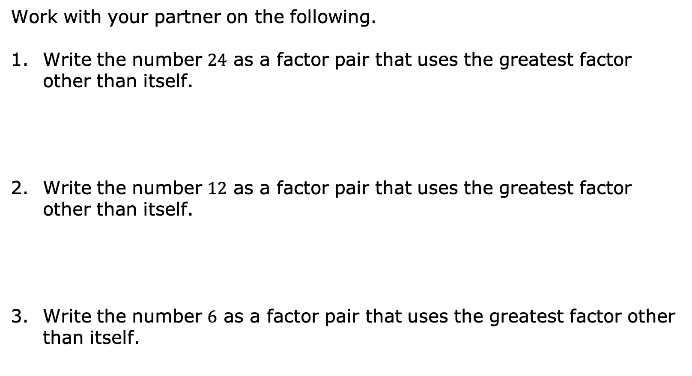
6.2.2 Collaboration: Exploring Factors
Work with your partner on the following.
Write the number $24$ as a factor pair that uses the greatest factor other than itself.
Write the number $12$ as a factor pair that uses the greatest factor other than itself.
Write the number $6$ as a factor pair that uses the greatest factor other than itself.
volume 1, pg. 239

Slide 9
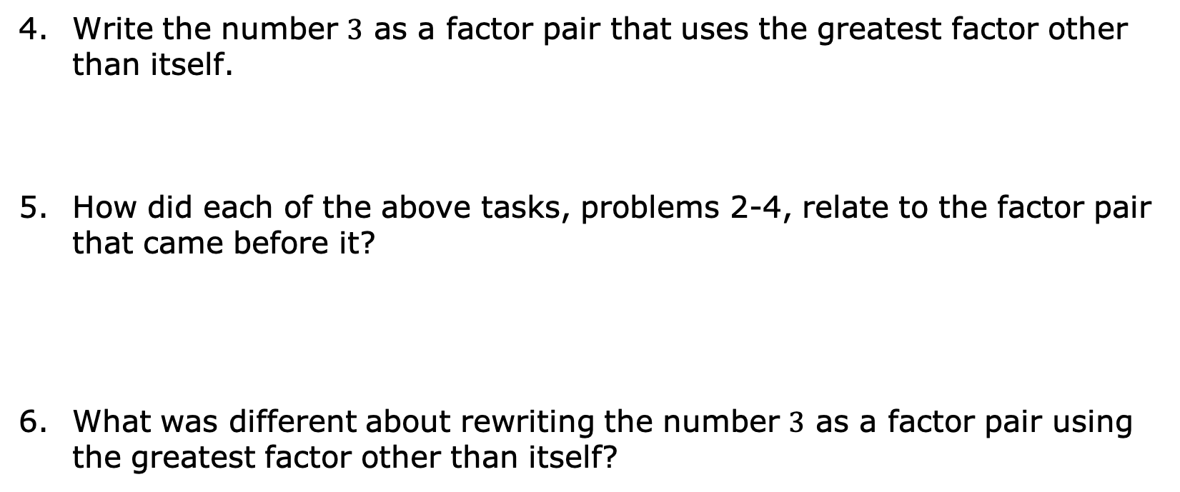
Write the number $3$ as a factor pair that uses the greatest factor other than itself.
How did each of the above tasks, problems 2-4, relate to the factor pair that came before it?
What was different about rewriting the number $3$ as a factor pair using the greatest factor other than itself?
volume 1, pg. 239

Slide 10

Guided Instruction
volume 1, pg. 239

Slide 11
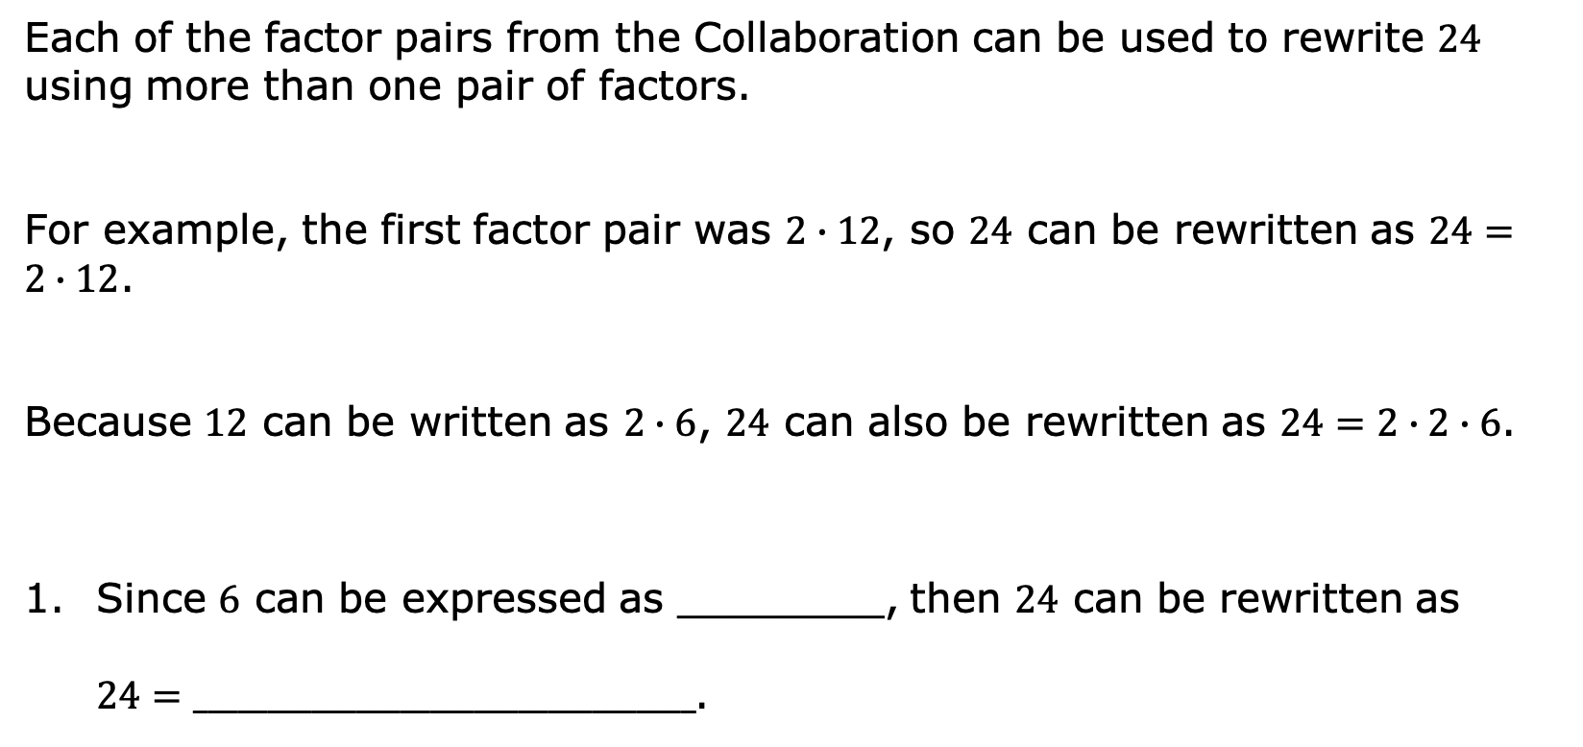
6.2.3 Guided Instruction: Prime Factorization
Each of the factor pairs from the Collaboration can be used to rewrite $24$ using more than one pair of factors.
For example, the first factor pair was $2∙12$, so $24$ can be rewritten as $24=2∙12$.
Because $12$ can be written as $2∙6$, $24$ can also be rewritten as $24=2∙2∙6$.
Since $6$ can be expressed as ________, then $24$ can be rewritten as $24=__________________________________$.
volume 1, pg. 239

Slide 12

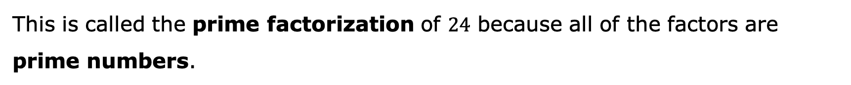

This is called the prime factorization of $24$ because all of the factors are prime numbers.
A prime number is a whole number greater than $1$ that is not divisible by any whole number other than $1$ and itself.
A prime factor is a factor that is a prime number.
Prime factorization is the expression of a number as the product of prime factors.
volume 1, pg. 239

Slide 13

Cory determined the prime factorization of $24$ using different factor pairs.
Explain whether Cory’s method changed the final result.
$$24$$ $$2 ∙ 12$$ $$3 ∙ 4$$ $$2 ∙ 2$$
Why did Cory circle the values he did?
volume 1, pg. 240

Slide 14






Find the prime factorization of $72$ by completing the work below.
The prime factorization of $72$ is ___________________.
$$72$$
$$36$$
$$2$$
$$18$$
$$2$$
volume 1, pg. 240

Slide 15
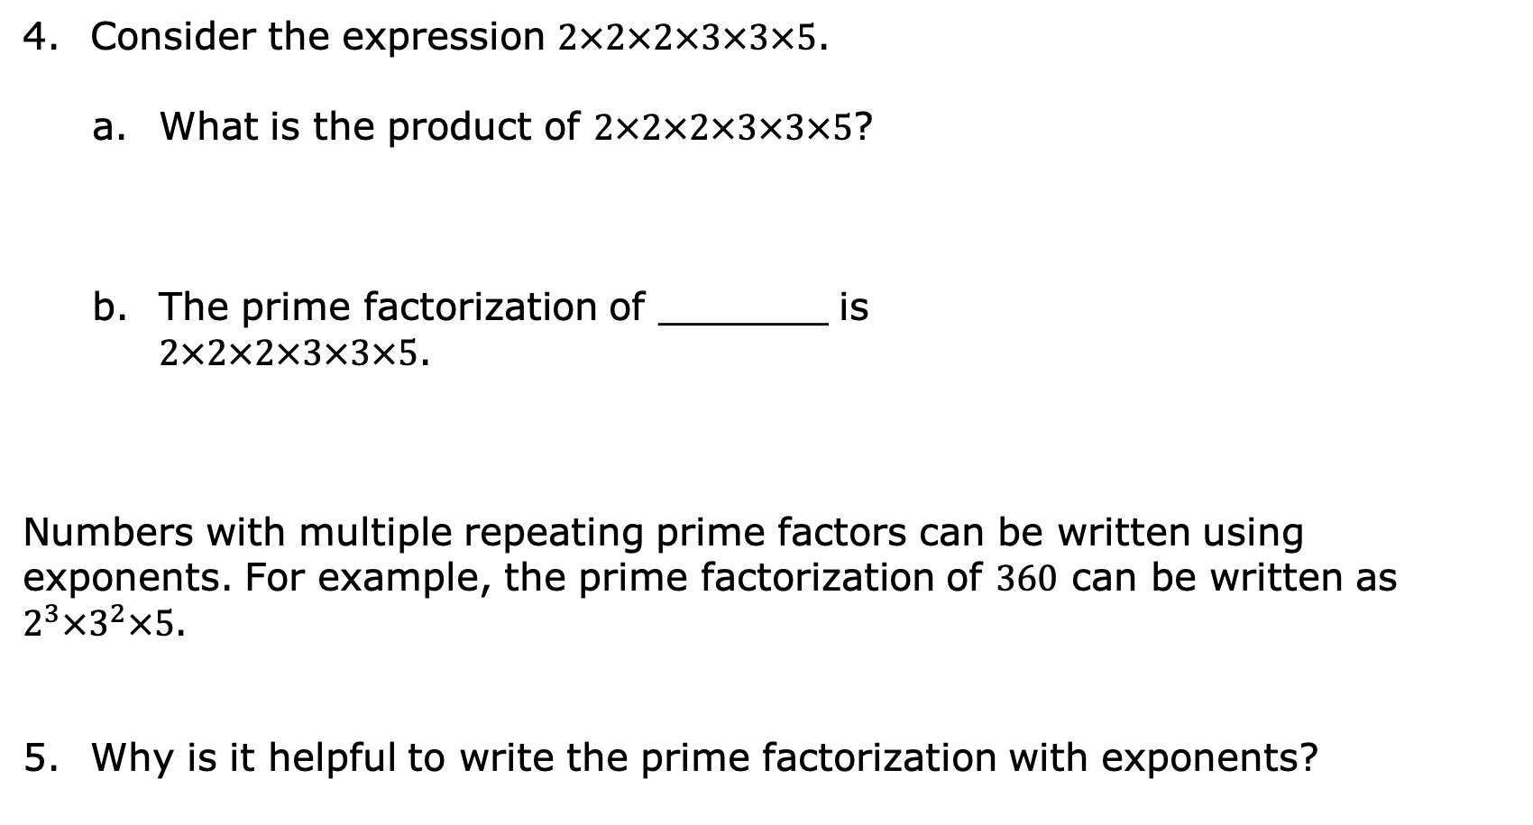
Consider the expression $2×2×2×3×3×5$.
What is the product of $2×2×2×3×3×5$?
The prime factorization of _______ is
$2×2×2×3×3×5$.
Numbers with multiple repeating prime factors can be written using exponents. For example, the prime factorization of $360$ can be written as $2^{3}×3^{2}×5$.
Why is it helpful to write the prime factorization with exponents?
volume 1, pg. 240

Slide 16

Guided Practice
volume 1, pg. 241

Slide 17

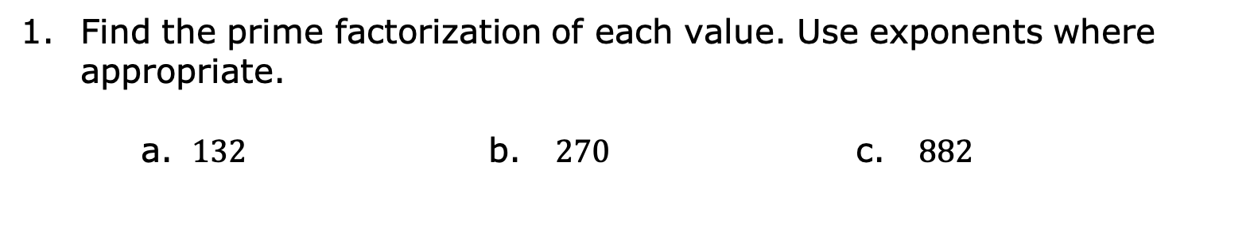
6.2.4 Guided Practice: Prime Factorization
Find the prime factorization of each value. Use exponents where appropriate.
$132$ b. $270$ c. $882$
volume 1, pg. 241

Slide 18

Sophie said the prime factorization of $210$ is $3∙7∙10$.
Determine the error Sophie made. Then, write her a brief note explaining her error and how she can learn from it.
What is the prime factorization of $210$?
Means
I
Start
To
Acquire
Knowledge
Experience
Skills
volume 1, pg. 241

Slide 19

Your Turn
volume 1, pg. 241

Slide 20


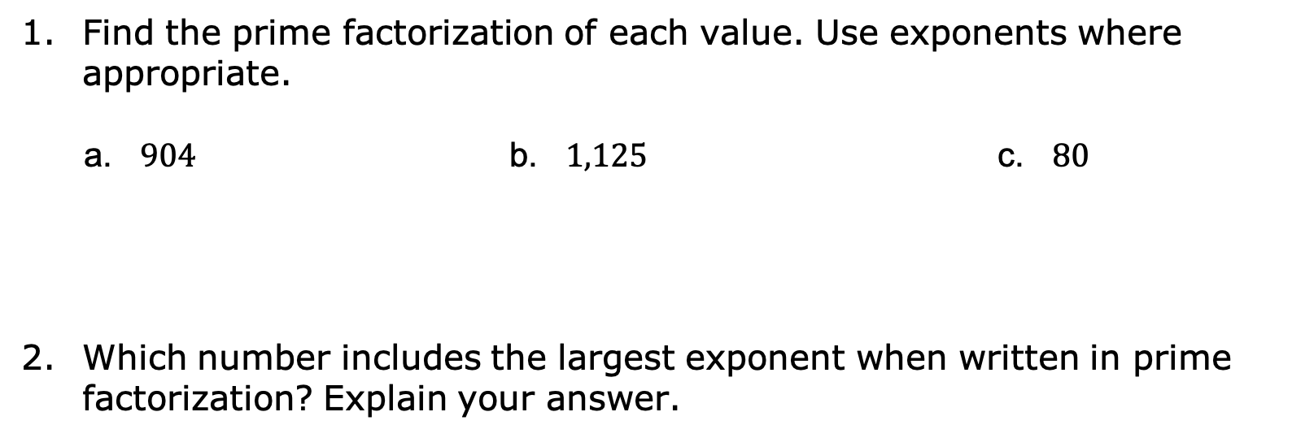
6.2.5 Your Turn!
Find the prime factorization of each value. Use exponents where appropriate.
a. $904$ b. $1,125$ c. $80$
Which number includes the largest exponent when written in prime factorization? Explain your answer.
$$5,670$$
$64$
volume 1, pg. 241

Slide 21
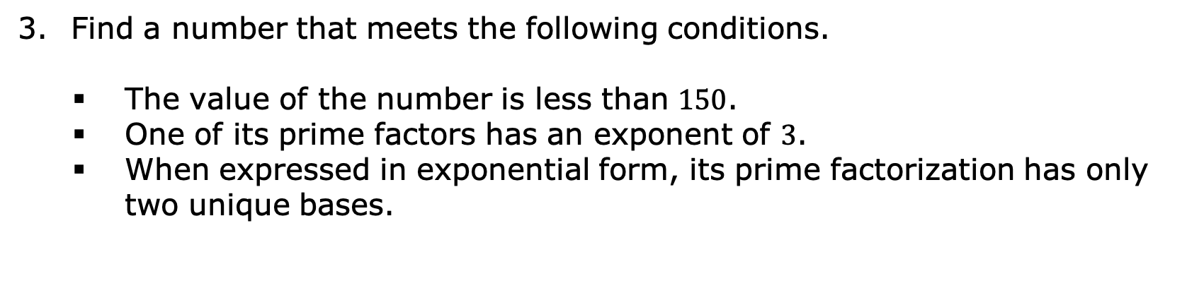
Find a number that meets the following conditions.
The value of the number is less than $150$.
One of its prime factors has an exponent of $3$.
When expressed in exponential form, its prime factorization has only two unique bases.
volume 1, pg. 241

Slide 22

Wrap-Up
volume 1, pg. 242

Slide 23

6.2.6 Wrap-Up: Ticket Out the Door
Find the prime factorization of each value. Use exponents where appropriate.
$168$
$1,040$
$144$
volume 1, pg. 242

